Slide 1
Battle of Neighborhood
Identifying best neighborhoods for inward migration to New York and London

Slide 2
Business Problem
New York and London are both very diverse cities and are the financial capitals of their respective countries and well-known financial centers in the world.
These organizations attract the best and the brightest of global talent and this has also meant that there is significant inward migration.
Most people migrating to these countries and jobs are of a certain age group (21+ to 35 years of age) this is primarily due to recruitment methods and immigrations laws in the US and the UK.
People in the 21+ to 35 years of age group, also referred to as Gen Y or Gen Z, are looking for a different lifestyle centered around comfort living, they want to stay close to stores, bars and restaurants so they don’t have to travel. The older among this age group might be young families and so they look for additional aspects like availability of nursery and possibly avenues to keep partners engaged
These people are the primary audiences of this report. In this report we will try to analyze the commercial hub within NY and London and recommend which neighborhoods are most suited for these individuals and should be considered should the option of migrating be available.
Online delivery has changed shopping patterns and this has impacted the traditional high street which is disappearing only to be replaced by high-rise office and residential buildings. This presents opportunities for various businesses.
These businesses are the secondary audience of this report. They will be able to make their investment decisions based on location recommendation within this report.

Slide 3
Data Acquisition, Cleaning and Evaluation Criteria
Data Source
Data Cleansing
Wikipaedia, Google Map and .json files
doogal.co.uk has information about Latitude and Longitude for City of London and Westminster
We will use Foursquare API’s, to get information about these neighborhoods. We will use the:
Venue Explore Option: Returns a list of recommended venues near the current location. This result will let us know what are the popular and what the people living within these locations like doing.
Venue Search Option: This will Returns a list of venues near the current location, matching a search category ID that will be provided based on the criteria mentioned above. This will let us conclude if the comfort living that Gen Y and Gen Z are looking for is possible.
Latitude and Longitude were present is different formats. These were:
Decimal degree e.g. 40.446° N 79.982° W
Degrees and decimal minutes e.g. 40° 26.767′ N 79° 58.933′ W
These were all converted into float format i.e. 40.446 and -79.982 so it can be used with Folium and Foursquare.

Slide 4
Data Acquisition, Cleaning and Evaluation Criteria
Data from the Foursquare API Search Query will be evaluated based on the criteria mentioned below
Primary Criteria:
Gen Y & Gen Z prefer comfort living, we will look at the availability of Residential Accommodation (High Priority) within the neighborhoods as this is to do with moving to these cities
Secondary Criteria:
Presence of Schools
Access to Medical & Dental Facilities
Gym and Fitness Centers
Parks & Playgrounds
Childcare Services
Laundromat and Laundry Services
Presence of Lifestyle Venues
Shopping Malls
Night Clubs and Lounge
Pubs and Sports Bars
Movie Theaters and Performing Arts Venues
Restaurants

Slide 5
Methodology
We collated data from various sources and cleansed the data so its in the right format and is consistent
We will explore this data, by visualizing it on Folium Maps to confirm we the right data or the right location
We will use the Foursquare API’s to get data about the neighborhood data from Search query and Explore query will be used
We will adopt K-means Clustering as a way of further exploring the data and segmenting it into clusters with similar features. This will be done for all data received from both the Explore and the Search options
The Clusters will be visualized on Folium Maps to ensure that the data is still intact and relevant to the analysis
We will explore that data in each neighborhood further by looking into businesses and services within the neighborhood. Data will be visualized in bar charts to identify if the best clusters which meet the criteria of data evaluation.
Cluster Selection:
Clusters from the Search query will be selected, based on how strongly they meet the criteria of data evaluation
Clusters from the Explore query will be selected based on size
The neighborhoods from each selected cluster will be made into Sets
An intersection of the Neighborhoods selected from the Search query cluster and a single Explore query cluster will be the recommended neighborhoods

Slide 6
Analysis of New York
Neighborhood in Manhattan

Slide 7
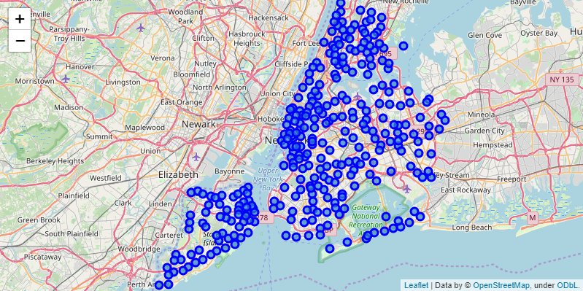
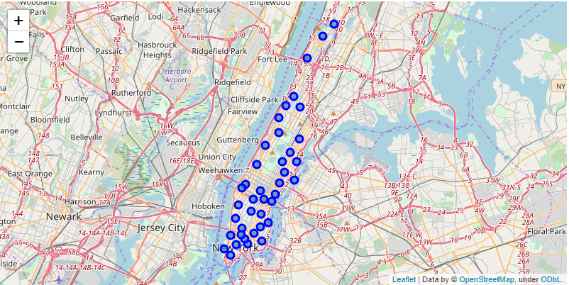
New York has 5 boroughs and 306 neighborhoods
Manhattan has 40 neighborhoods
Foursquare API Explore was used to get recommended venues within 500 meters of the neighborhood latitude and longitude information with us.
As a result of this we identified 3279 recommended venues in 330 unique categories.

Slide 8
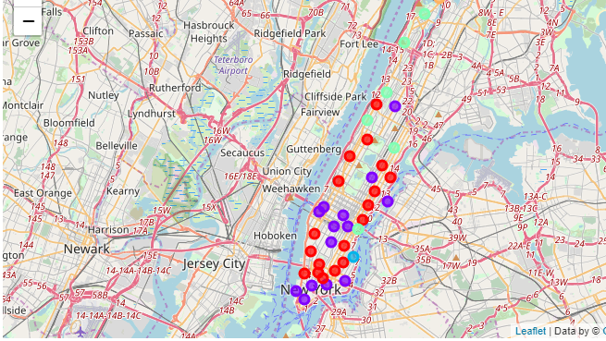
K-means Clustering
Foursquare API Explore Query
We used k-means clustering to develop 5 clusters from the neighbourhood data we have. The result was then visualized on Folium maps.

Slide 9
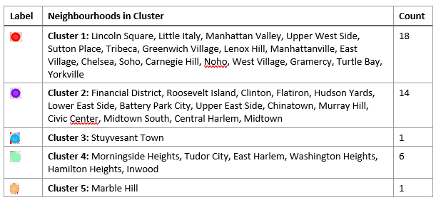
As the largest cluster, we would use Cluster 1 as the first cluster for intersection with the cluster from the search clusters.

Slide 10
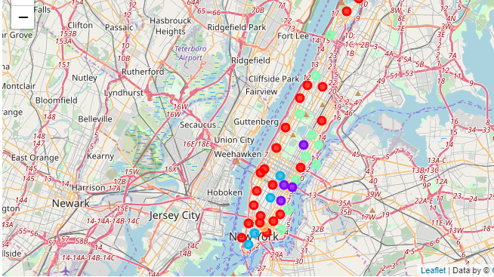
K-means Clustering
Foursquare API Search Query
We used k-means clustering to develop 5 clusters from the neighbourhood data we have. The result was then visualized on Folium maps.

Slide 11
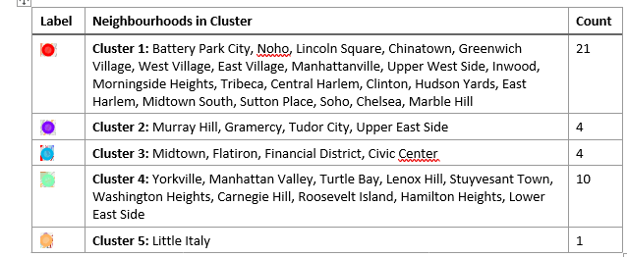

Slide 12
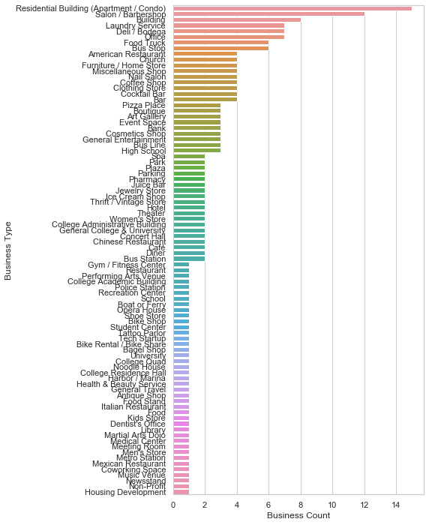
The primary criteria for our target audience is the availability of residential Accommodations. This criteria is best met in this cluster. Furthermore, all secondary criteria are also me.
We will use Cluster 1 in further analysis to identify neighborhoods suitable for the target audience.

Slide 13
Analysis of London
Neighborhood in City of London & City of Westminster

Slide 14
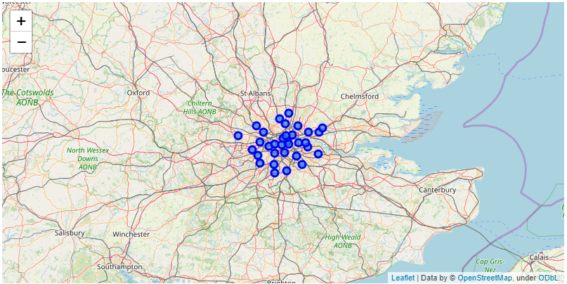
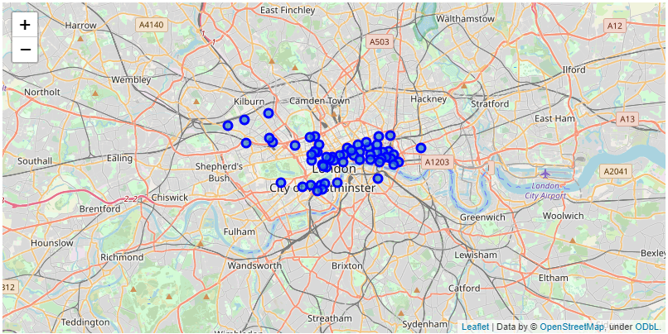
London has 33 boroughs
A total of 59 neighborhoods were identified within the boroughs of the City of London and the City of Westminster
Foursquare API Explore was used to get recommended venues within 500 meters of the neighborhood latitude and longitude information with us.

Slide 15
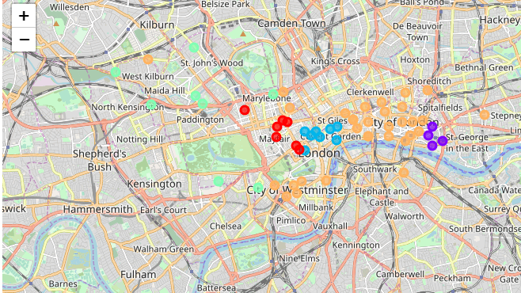
K-means Clustering
Foursquare API Explore Query
We used k-means clustering to develop 5 clusters from the neighbourhood data we have. The result was then visualized on Folium maps.

Slide 16
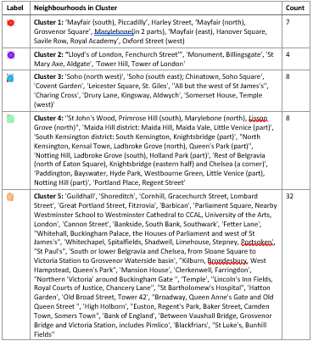
As the largest cluster, we would use Cluster 5 as the first cluster for intersection with the cluster from the search clusters.

Slide 17
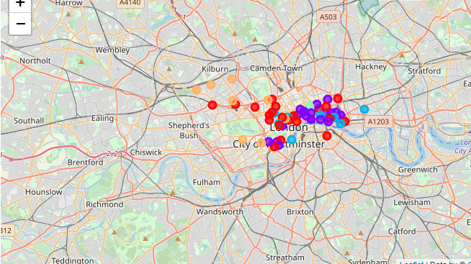
K-means Clustering
Foursquare API Search Query
We used k-means clustering to develop 5 clusters from the neighbourhood data we have. The result was then visualized on Folium maps.

Slide 18
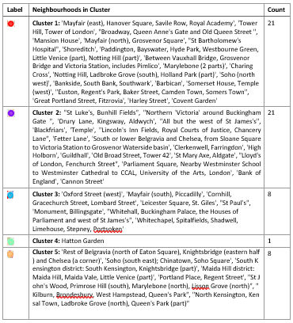
Both Cluster 1 & 2 are equal size so we will have to evaluate both Clusters to before deciding which Cluster to consider

Slide 19
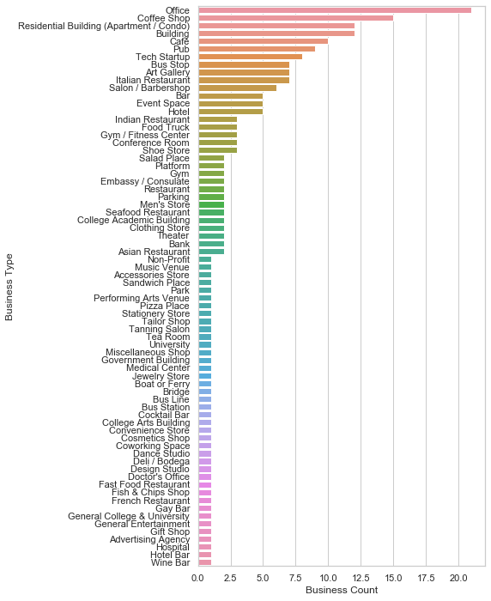
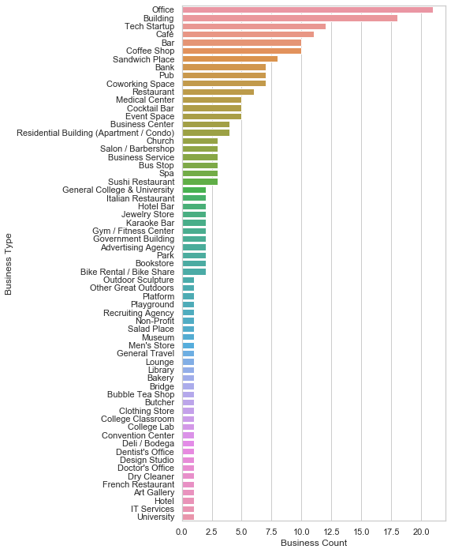
In comparison to Cluster 2, its clear that Cluster 1 has significantly greater Residential accommodation and will therefore be considered for analysis.
Cluster 1
Cluster 2

Slide 20
Recommendations
Neighborhood in
Manhattan
City of London & City of Westminster

Slide 21
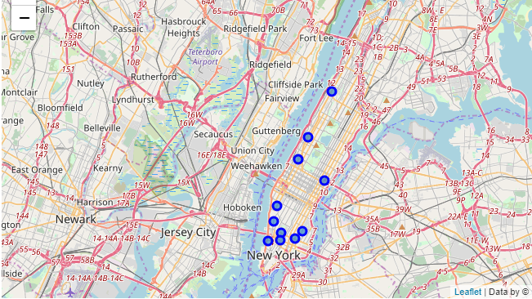
Manhattan
Cluster 1 from the K-means of both the Explore Query and the Search Query were identified as the most suitable. The neighborhoods from both clusters were put in sets.
An intersection of both sets is the set of recommended neighborhoods which the target audience should consider should they want to relocate to Manhattan.
A total of 11 Neighborhoods were included.
Neighborhoods recommended are 'Lincoln Square', 'Sutton Place', 'Greenwich Village', 'East Village', 'Soho', 'Tribeca', 'Manhattanville', 'Upper West Side', 'Noho', 'West Village', 'Chelsea'.

Slide 22
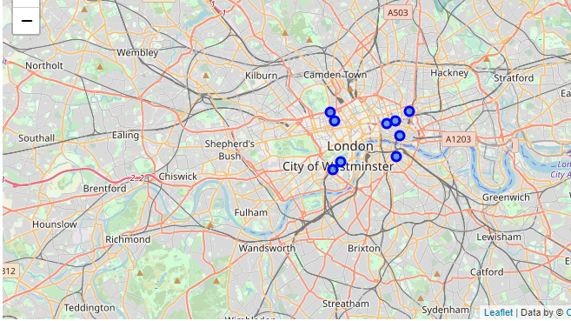
City of London and Westminster
Cluster 1 from the Search Query results and Cluster 5 from the Explore Query results were identified as the most suitable. The neighborhoods from both clusters were put in sets.
An intersection of both sets is the set of recommended neighborhoods which the target audience should consider should they want to relocate to the City of London & City of Westminster.
A total of 9 neighborhoods were identified.
Neighborhoods included are 'Barbican', 'Between Vauxhall Bridge, Grosvenor Bridge and Victoria Station, includes Pimlico', "St Bartholomew's Hospital", 'Shoreditch', 'Mansion House', "Broadway, Queen Anne's Gate and Old Queen Street ", 'Great Portland Street, Fitzrovia', "Euston, Regent's Park, Baker Street, Camden Town, Somers Town", 'Bankside, South Bank, Southwark'.

Slide 23
Observations and Conclusions

Slide 24
Observations
The explore query returns recommended venues and these are then selected. As part of this project we will be identifying the intersection of the selected ‘Search’ query cluster and the largest ‘Explore’ query cluster to recommend neighborhoods that offer a certain level of features uniformly. This will be the best fit result.
The limitation is because we can have intersections between the selected ‘Search’ query cluster, and any ‘Explore’ query cluster. Assuming the intersection is not a null set it’s a potential target neighborhood to consider that offers a different level of features uniformly.
This will depend on individual target audience and for the purpose of this report the other option are ignored.

Slide 25
Conclusion
In this report we analyzed the neighborhoods of Manhattan and the City of London and City of Westminster. We used Foursquare API’s Explore and Search to get location specific data. The results we got from the query became the data set for further analysis. We used K-means clustering as a way of identifying neighborhoods with similar features and used the criteria of evaluation set to shortlist key cluster. Set theory was applied on the neighborhoods and the intersection of the 2 sets became the recommended cluster.

